Slide 1


Data Analytics

Slide 2


Today’s Agenda
Project Recap
To provide a High-Level overview of the business problem.
Problem
Our team will delve into the focal matter we've been diligently addressing, aiming to unveil profound insights.
The Analytics Team
We will commence by delineating the core issue at hand, followed by an elucidation of the team tasked with its resolution
Process
Afterwards, I'll outline the steps taken to complete the assignment for a clearer understanding.
Insights
I'll review all significant findings
Summary
Ultimately, I will consolidate and present a summary of the key findings for comprehensive understanding and decision-making

Slide 3

“Social buzz” is the fast-growing technology
unicorn that need to adapt quickly to its global
scale. Accenture has begun a 3-month POC
focusing on these tasks:
An audit of Social Buzz’s big data
practice.
Recommendation for a successful IPO.
Analysis to find Social Buzz’s top 5
popular categories of content
Project Recap

Slide 4

In recent years, our client base has experienced significant growth, outpacing available internal resources for management. Social Buzz receives over 100,000 daily posts, accumulating to 36,500,000 annually. Given the unstructured nature of this content, deciphering its meaning presents a formidable challenge. Key project specifications include: 1: Data Integration: Combining tables from the sample dataset. 2: Content Analysis: Conducting an in-depth examination of content categories to identify the top five with the highest total popularities.
Problem

Slide 5


Myself Data Analyst Marcus Rompton Senior Principle Andrew Fleming Chief Technical Architect
The Analytics team

Slide 6
Process
1
Understanding Data
Data Cleaning
2
3
Data Modeling
4
Data Analysis
5
Uncover Insights

Slide 7

Insights
Animal
Unique Categories
Category with highest score
Month with most posts
16
75K
MAY

Slide 8
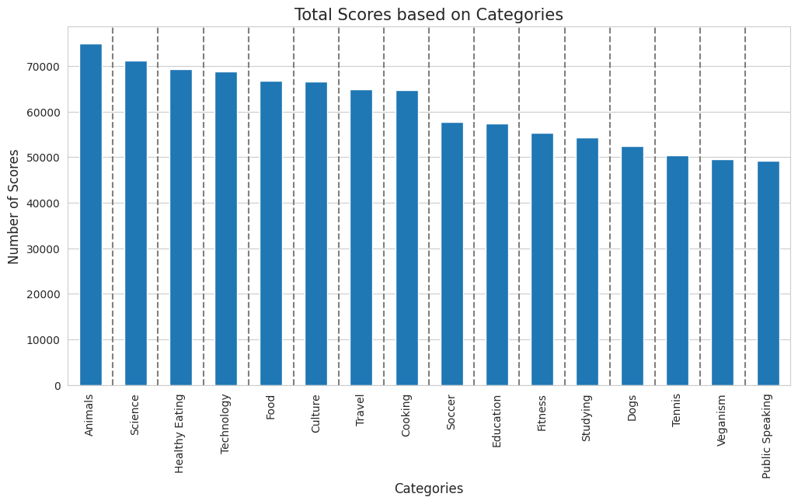
This bar chart represents all “Categories”. According to the analysis of the graph, the Animal category attained the highest score, reaching approximately 75k, while the Public Speaking category recorded the lowest score, around 50k.

Slide 9
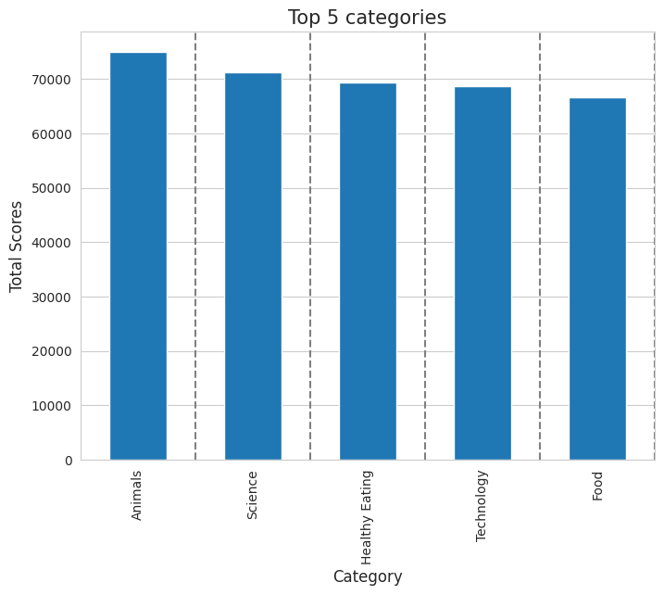
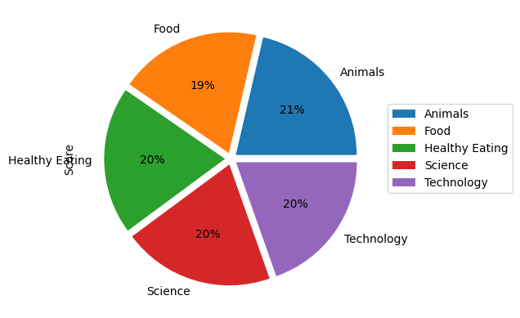
The bar chart and pie chart represent the “Top 5 Categories”, highlighting their respective scores. Notably, the Animal category achieved the highest score, while the Food category attained the lowest score among these top 5 categories. This subtle variance underscores the diverse performance across these segments.

Slide 10

Animals and science emerge as the two most popular content categories, reflecting a strong preference among users for 'real-life' and factual content. Therefore, I recommend prioritizing the creation of more content in these categories to capitalize on user interest and engagement. Food consistently appears as a prevalent theme within the top 5 categories, with 'Healthy Eating' content securing the highest rank. This insight presents an opportunity to leverage the audience's inclination towards healthy eating by collaborating with relevant brands in this space to enhance engagement and foster brand advocacy. The presence of technological content among the top category's underscores users' interest in technology-related subjects. This suggests a receptive audience for your technological material. I recommend exploring partnerships with leading digital companies to further leverage this interest and drive increased user engagement.
Summary
Analysis
Insight
Next Step

Slide 11
Thank you!
ANY QUESTIONS?

